Slide 1
SQL Challenge
Thrice Done
Evolution of a Kata
November, 2019
KROLL BOND RATING AGENCY, INC

Slide 2
Agenda
Pete
SQL Server (Relational)
Short
Long
Graph
Ahh
RStudio
We’ll see
Notes:
I am very impressed with the level of professionalism that JC aspires to, …, for you. JC does many things to elevate you, well us. Book clubs, symposiums, hackathons, game nights (camaraderie is part of professionalism, you can’t sit at your desk), quizzo, office battles, conferences, meetups… A recent topic of discussion was smells. And I think, well what are they talking about, a brown pile of _____? Well that stinks. Converting that to a visual metaphor you could say “That code looks like _______” (Not part of my elegant lifestyle). Aesthetics are important. Nobody wants to work in code that looks like __________ . So this now brings us to Katas. Honing your skills. Practicing your craft. I am going to present to you today how this (show print out) whiteboard challenge has evolved into a kata.

Slide 3
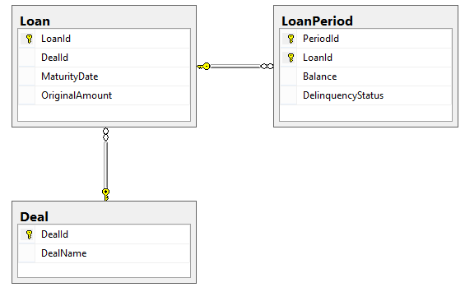
SQL
Notes:
This Entity Relationship Diagram appears on the top of the Whiteboard challenge sometimes used for candidates applying for a data oriented position. I find this ERD to be very useful. It tells me what’s what and where is it. I find this visual to be very appealing.

Slide 4
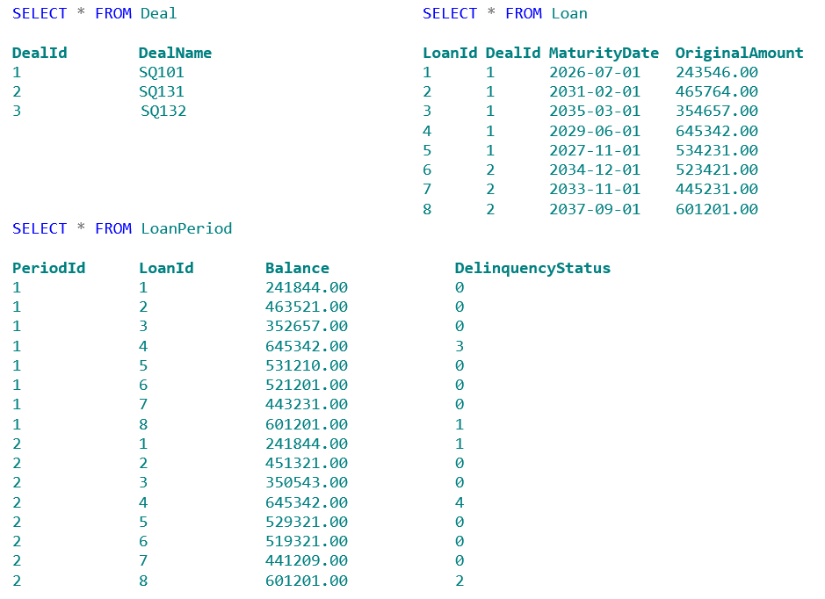
SQL
Notes:
Here is the data to be contained in the database described by the ERD.

Slide 5
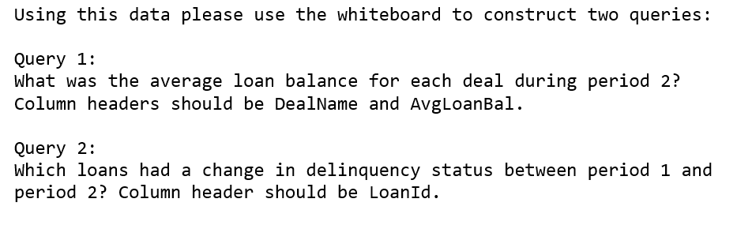
SQL
Notes:
After candidates have had a chance to ask questions they are asked to go to the Whiteboard and write out these queries.

Slide 6
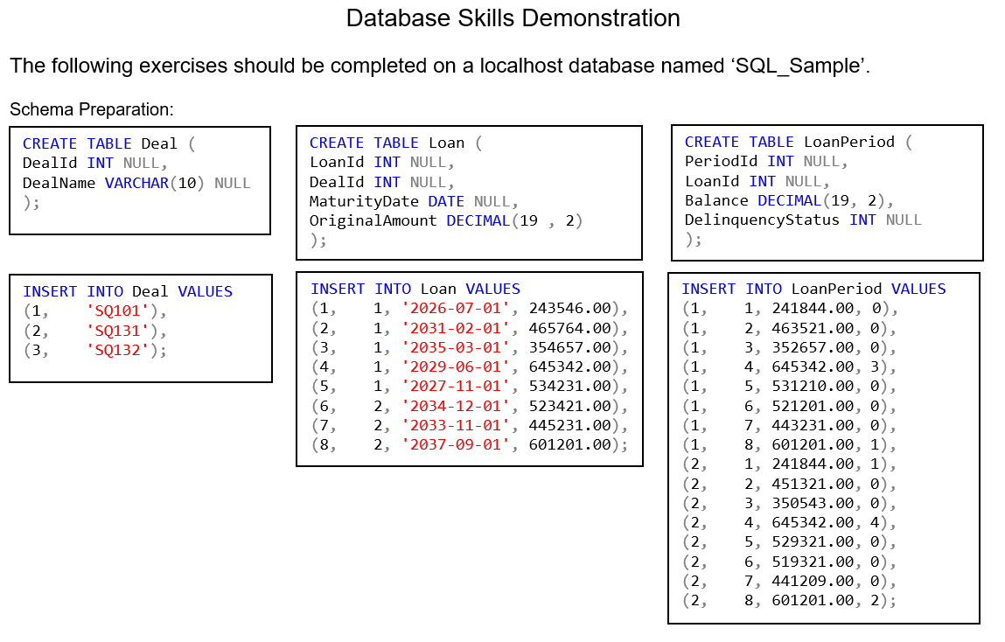
SQL
Notes:
This is the take-home or live version.

Slide 7
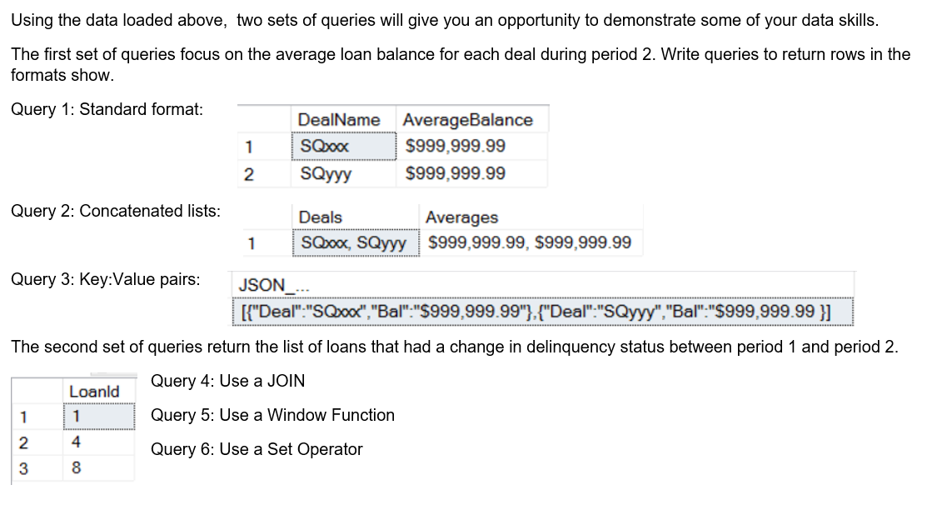
SQL
Notes:
The second set of queries can be done 4 way.

Slide 8
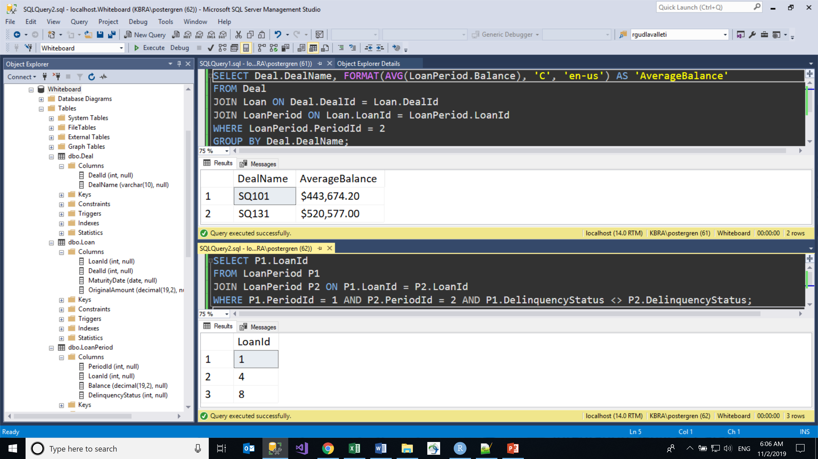
SQL
Notes:
Solutions showing correct results.

Slide 9
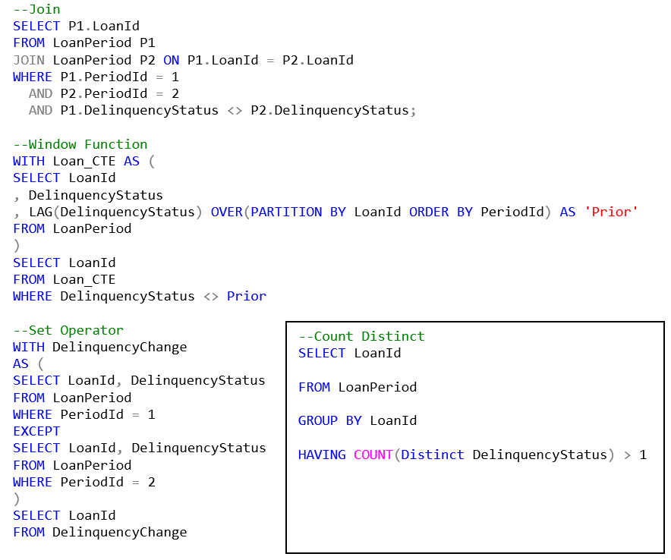
SQL
Notes:
Also received these solutions, note the 4th version that was not included on the question set.

Slide 10
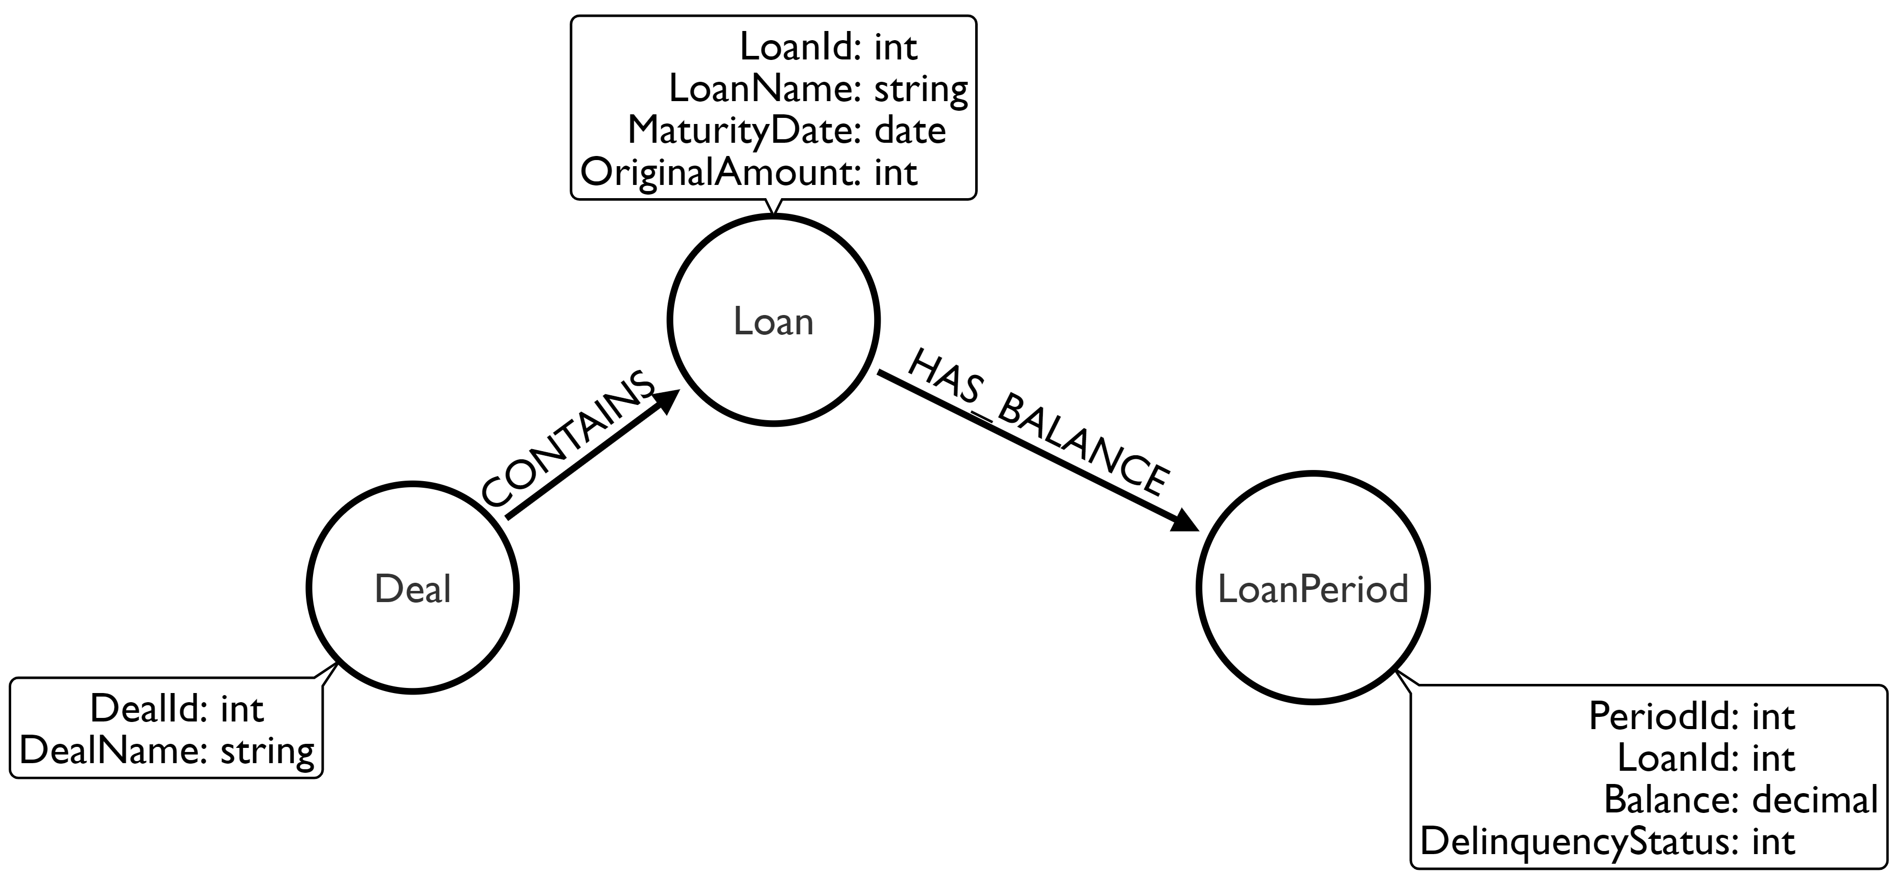
Graph Model
Notes:
The Graph Model version of the Whiteboard Challenge. Given a graph data base that has these three nodes with these two relationships, use this Labeled Property Graph diagram and ….

Slide 11
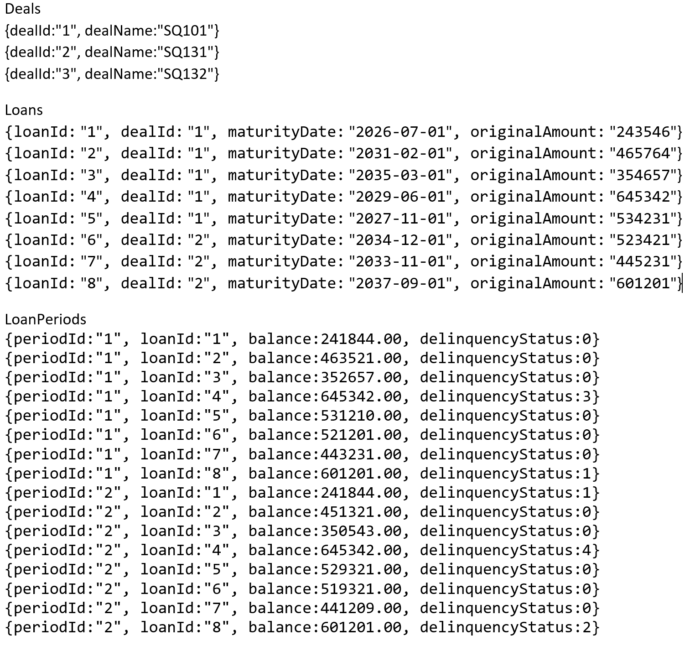
Graph Model
Notes:
That contains this data.

Slide 12
Graph Challenge
Notes:
After candidates have had a chance to ask questions they are asked to go to the Whiteboard and write out these queries.

Slide 13
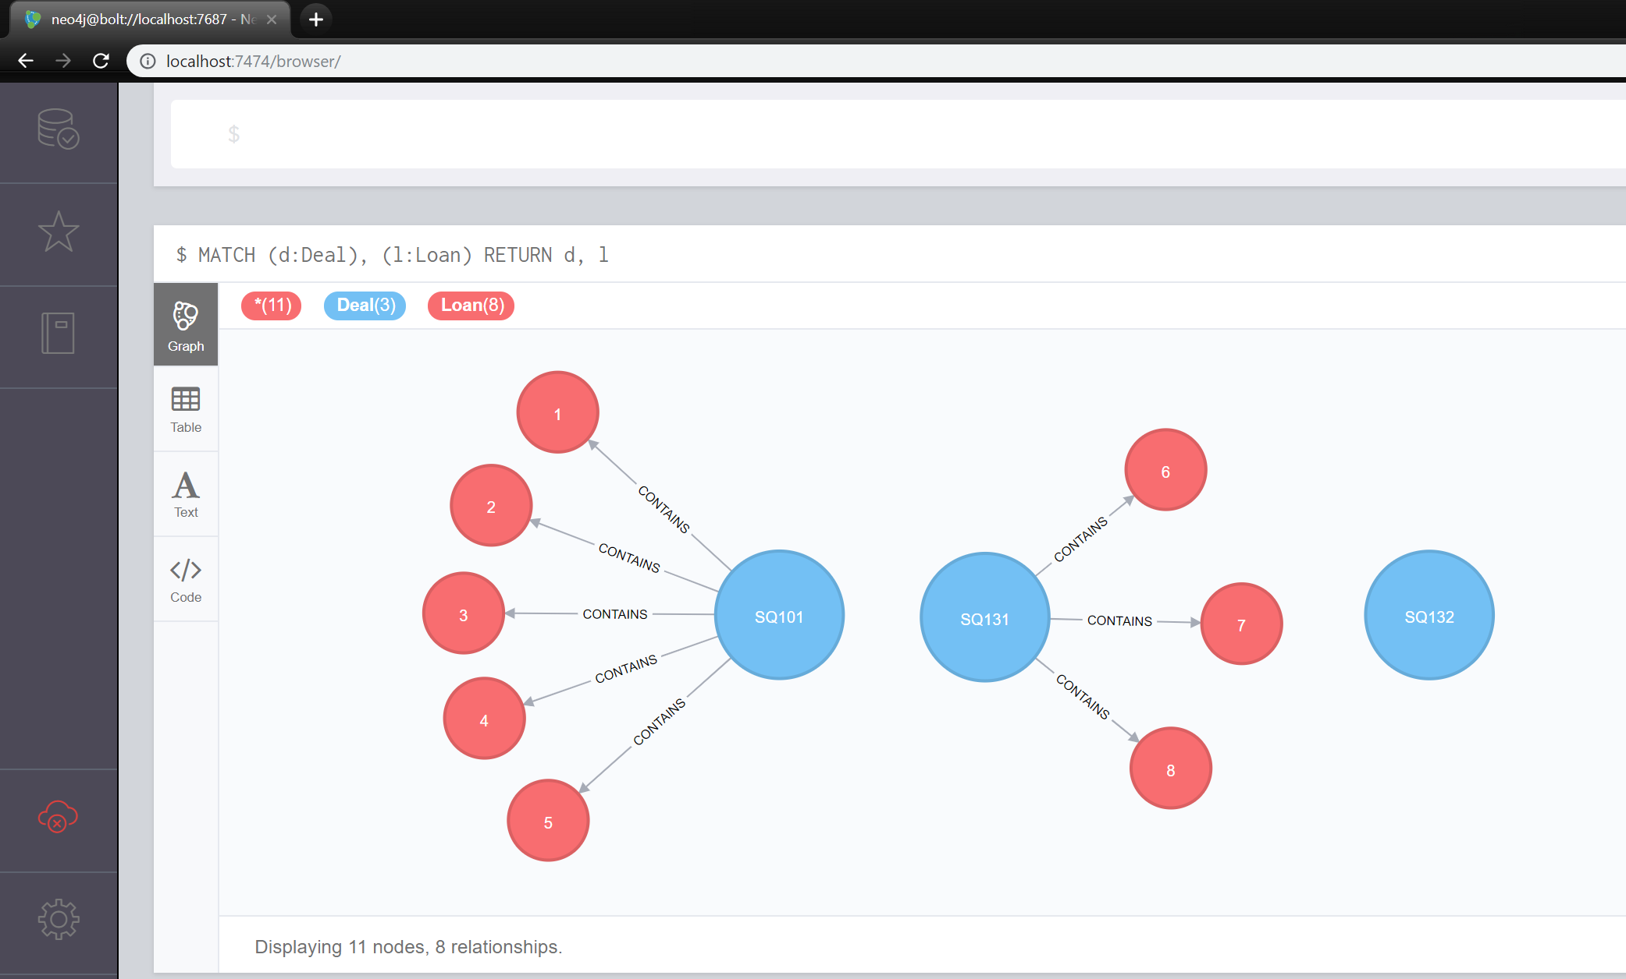
Graph Model
localhost
Notes:
The Graph answer will ‘look’ like this.

Slide 14
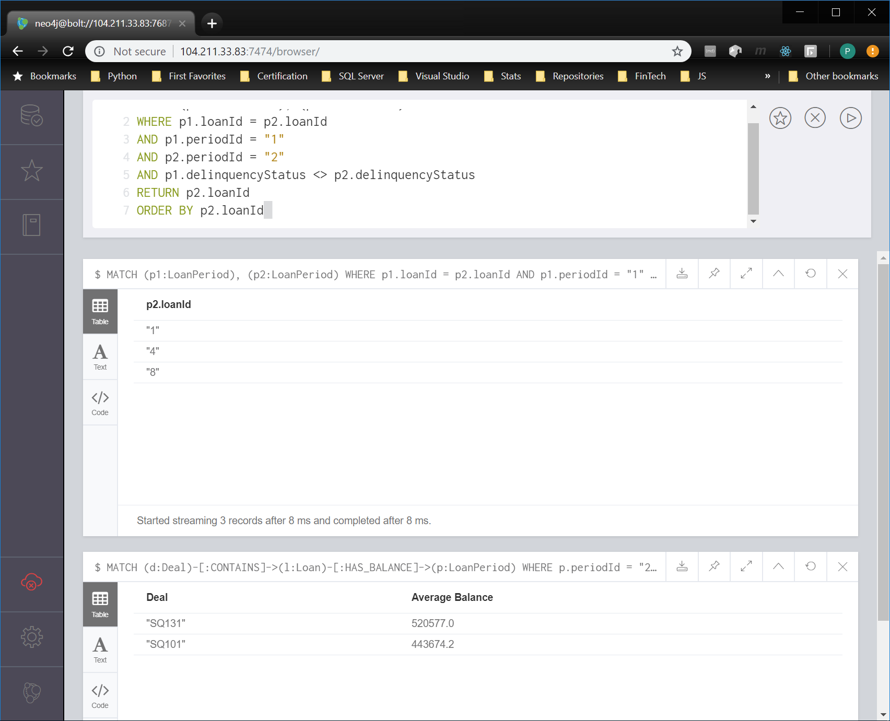
Graph Model
azure pip
Notes:
And the Graph answers will show the same values. Query results panes scroll down as they are executed.

Slide 15
Cheat sheet
Java
jdk-10.0.1_windows-x64_bin.exe
JAVA_HOME C:\Program Files\Java\jre-10.0.1
PATH ;C:\Program Files\Java\jre-10.0.1\bin\server
Download
neo4j-community-3.4.0-windows.zip
Create Operating Folder
C:\graph
Copy in Zip contents
Start Server from CMD Run as Administrator
cd /.
cd graph/bin
neo4j console
Open Browser
localhost:7474
Username: neo4j
Password: neo4j
Notes:
This is all you need to setup an environment to run the Graph Challenge. Should we do a live demo right now? Should take about three minutes. (jiggly round things)

Slide 16
Graph Vignettes
:play intro
:play start
:play concepts
:play cypher
:play write-code
:play movie-graph
:play northwind-graph
Notes:
This is all you need to setup an environment to run the Graph Challenge. Should we do a live demo right now? Should take about three minutes. (jiggly round things)

Slide 17
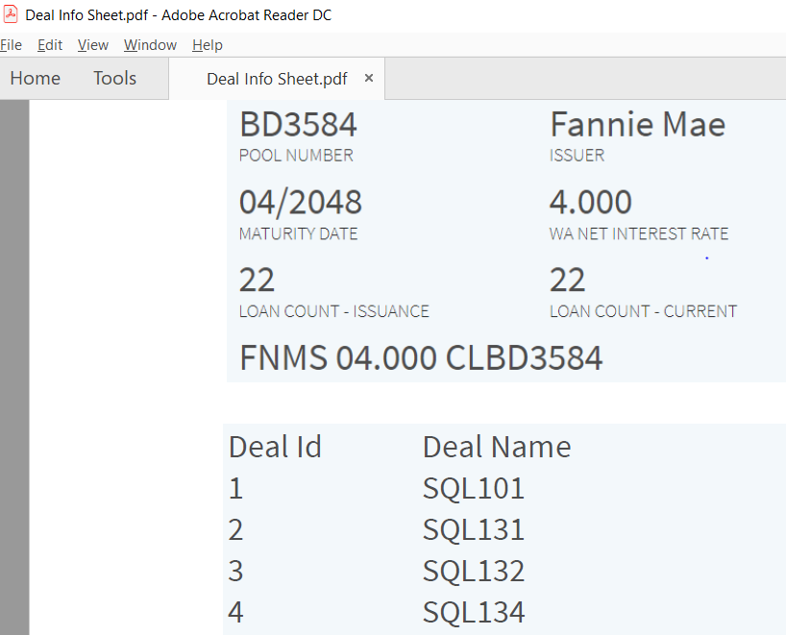
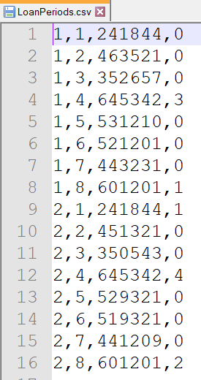
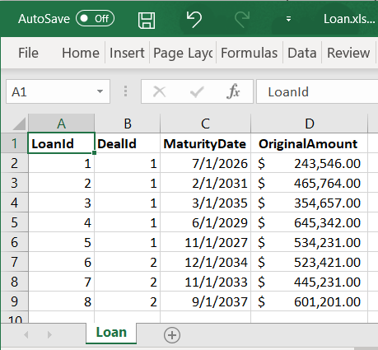
Analyst Challenge
Notes:
This is our assignment: Given these data sources use R to create the monthly ‘Bal-Stat’ report in a PDF file.
Specifically you manager tells you to:
Take the first three deals from this PDF, with each deal containing the loans Excel file, calculate the average loan balance in period 2 as shown in the CSV file. After that create a list of loans that had a change in delinquency status between period 1 and period 2.

Slide 18
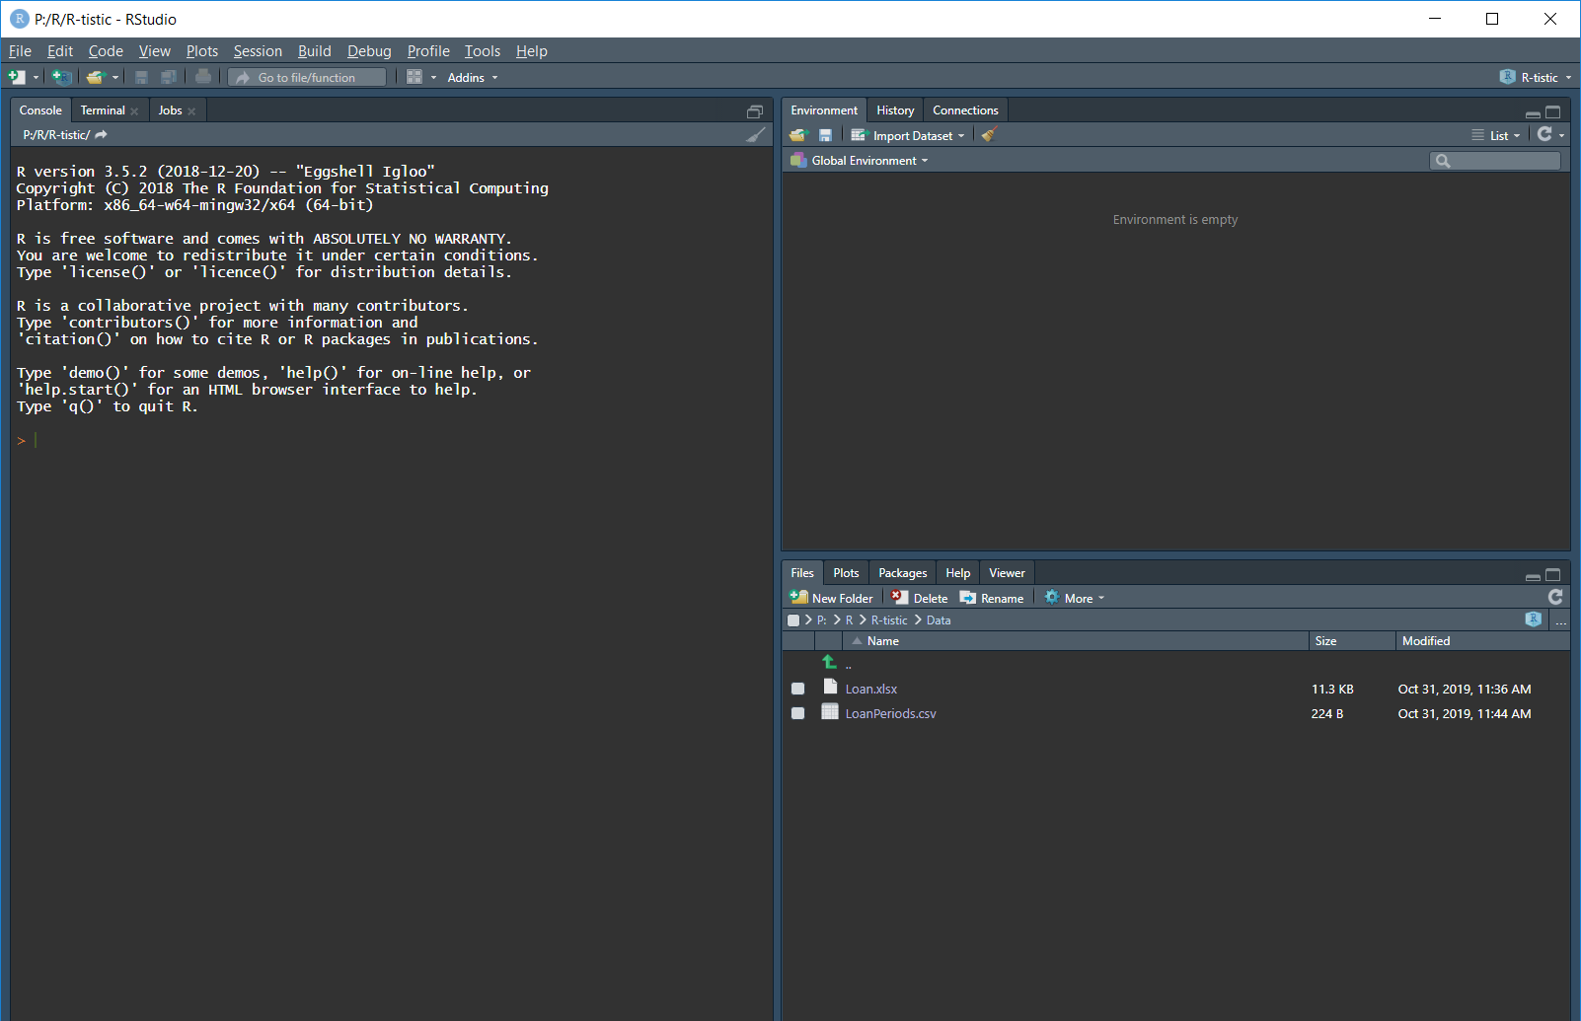
R in RStudio
Notes:
Here I have opened a new R project in a folder that contains the data files. Step 1 I will visually inspect the PDF document and manually enter into the R environment. The document contains information on the deals, so I will create a thingy called “deals” and put in three sets of DealId and DealName. I will ‘put’ the stuff from the right side into the variable name on the left with an arrow. I will use a function called rbind(). This function will bind together the collections I give it into rows. At this point R will arrange these three sets into rows. The contents can be viewed by typing deals and return. Of course R did not know what column names to use so we can use the colnames() function to put them into the deals object. Again we use the c() function to collect together the column names. (c() combine or concatenate)
Or build a data frame with two vectors of values

Slide 19
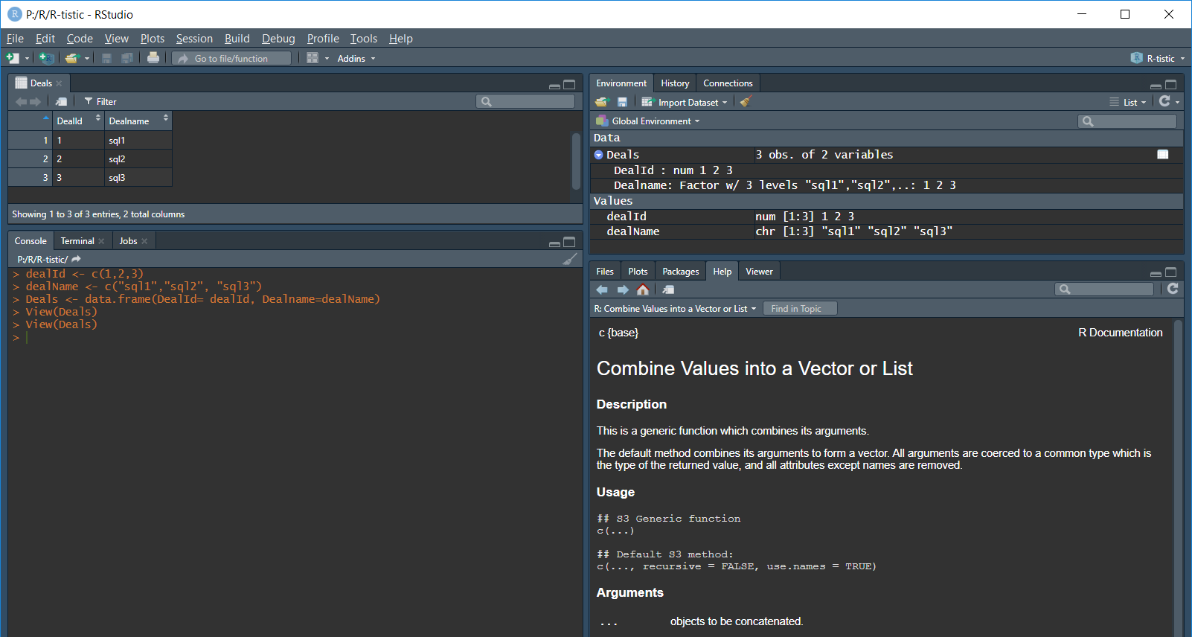
R in RStudio
Notes:
The Deal info in a Data Frame. First create a vector with a list of DealId’s. Second into the object DealName put a vector of deal names. Finally arrange these two vectors in a data frame.

Slide 20
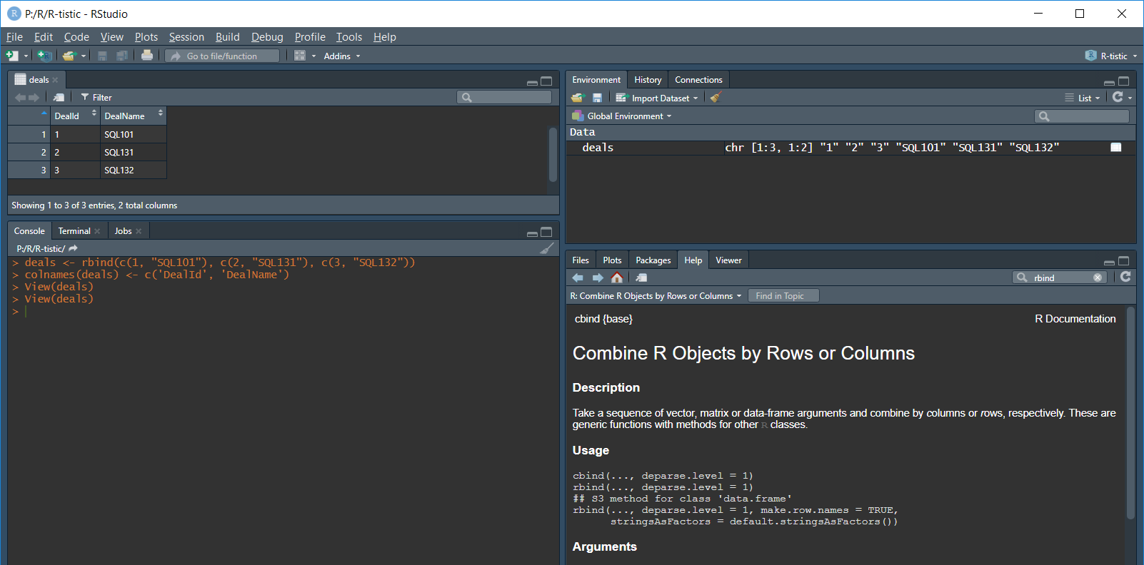
R in RStudio
Notes:
Alternatively you could ‘bind’ three vectors in rows, then assign names to the columns.

Slide 21
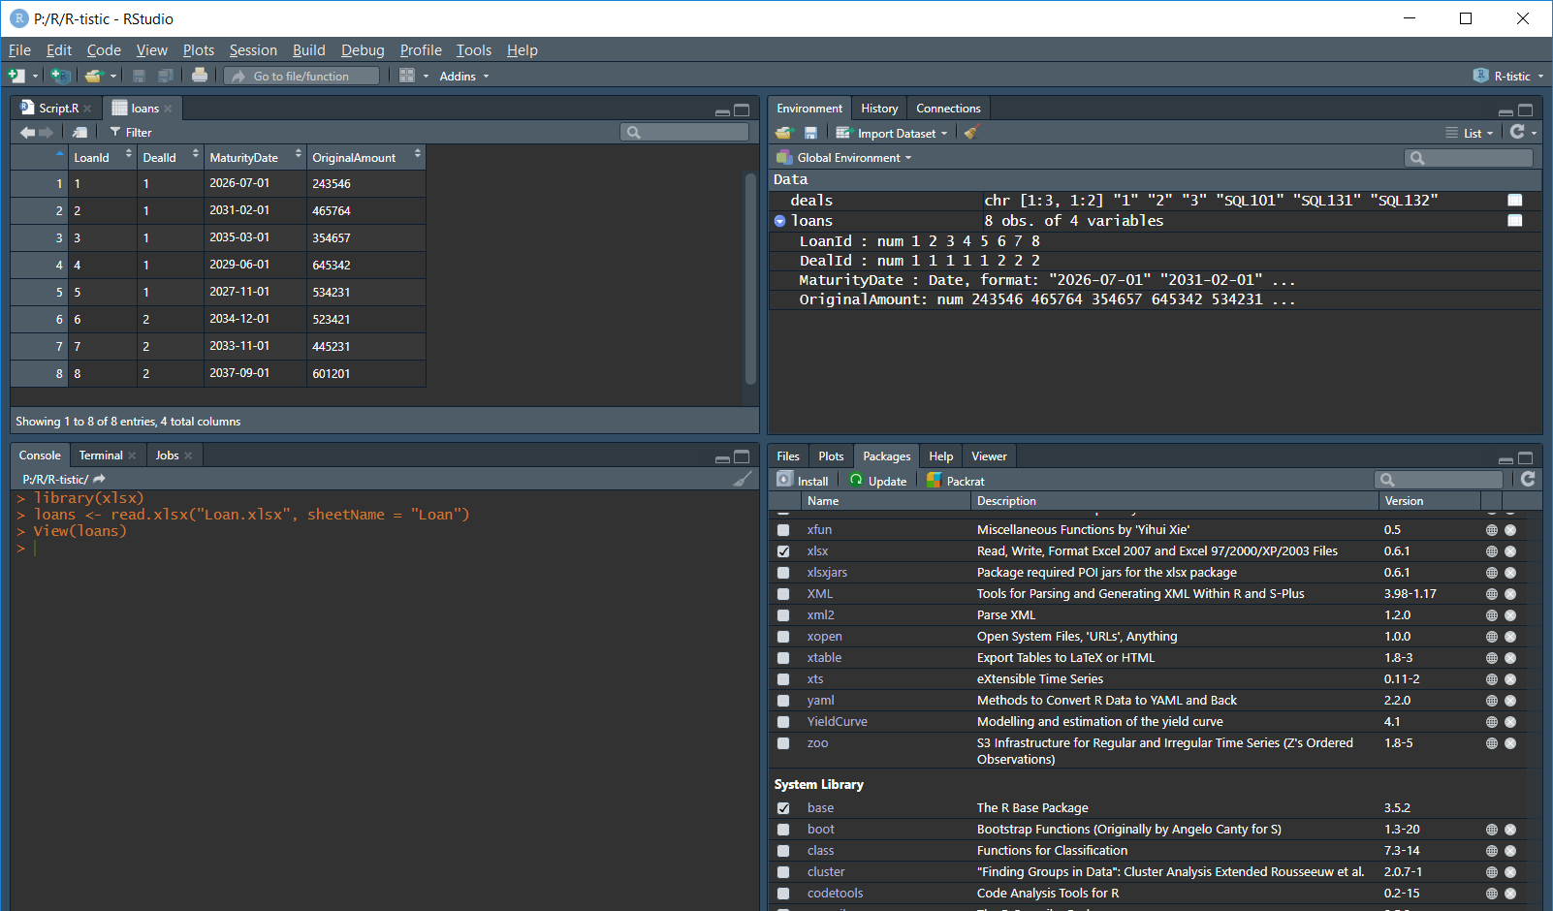
R in RStudio
Notes:
Using the xlsx library import the worksheet with one line.

Slide 22
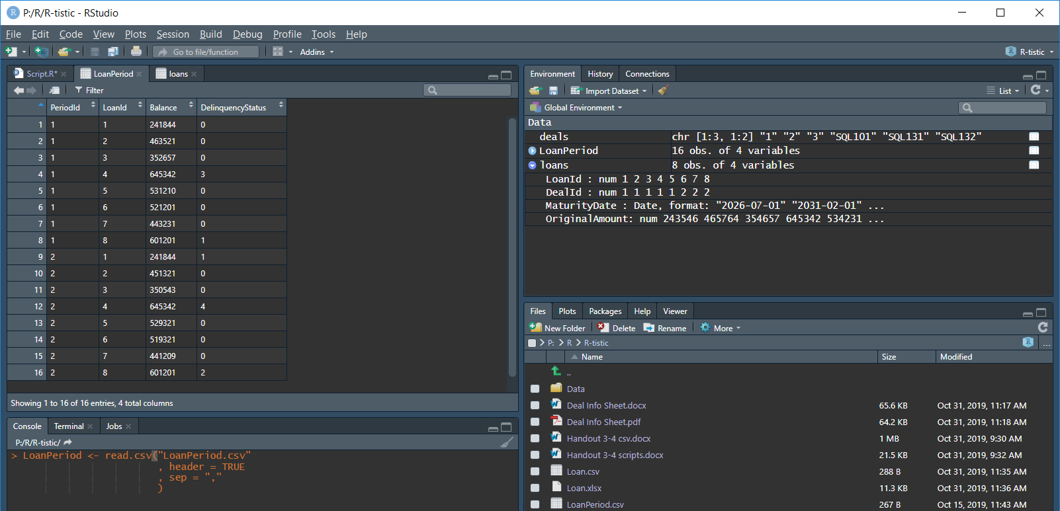
R in RStudio
Notes:
The built in Data Input functions read the CSV file. Note: header = TRUE because the file contains headers.

Slide 23
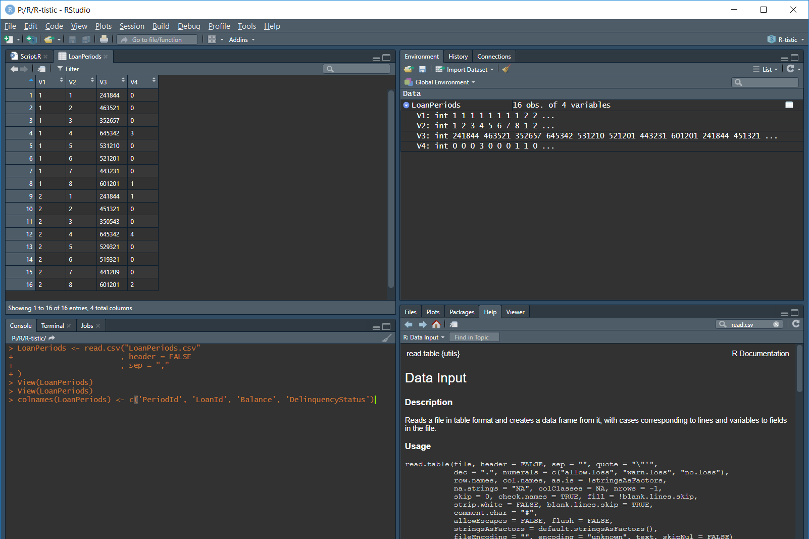
R in RStudio
Notes:
With or Without headers. Set header = FALSE so we do not treat the first row as a header. We supply the headers with the colnames() function.

Slide 24
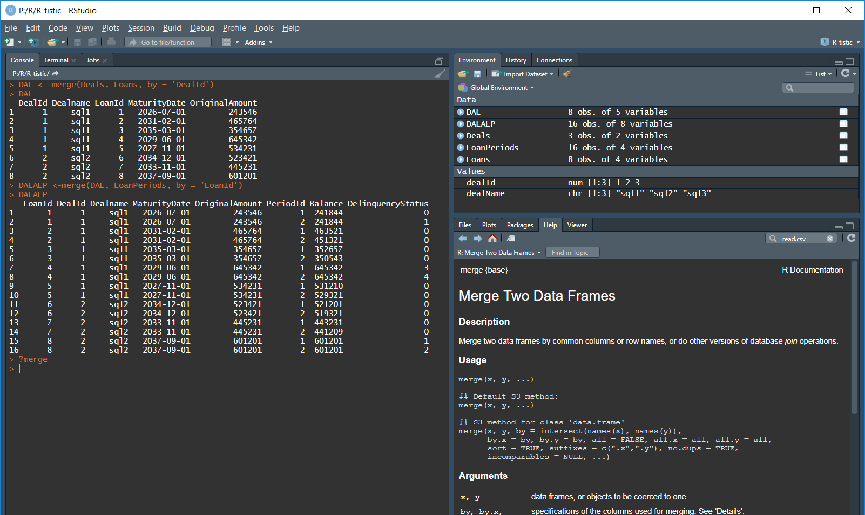
R in RStudio
Notes:
Assemble the individual objects together into one Data Frame to be analyzed. Here I am showing two steps to create one de-normalized set of data.

Slide 25
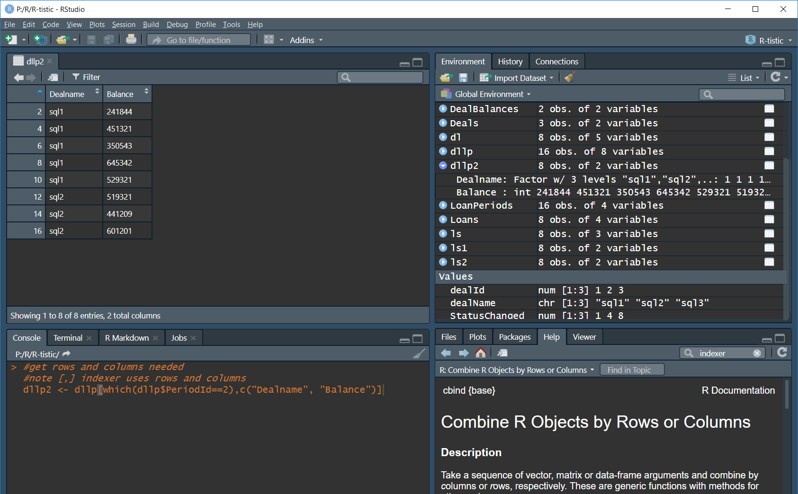
R in RStudio
Notes:
Get the rows that are in Period 2.

Slide 26
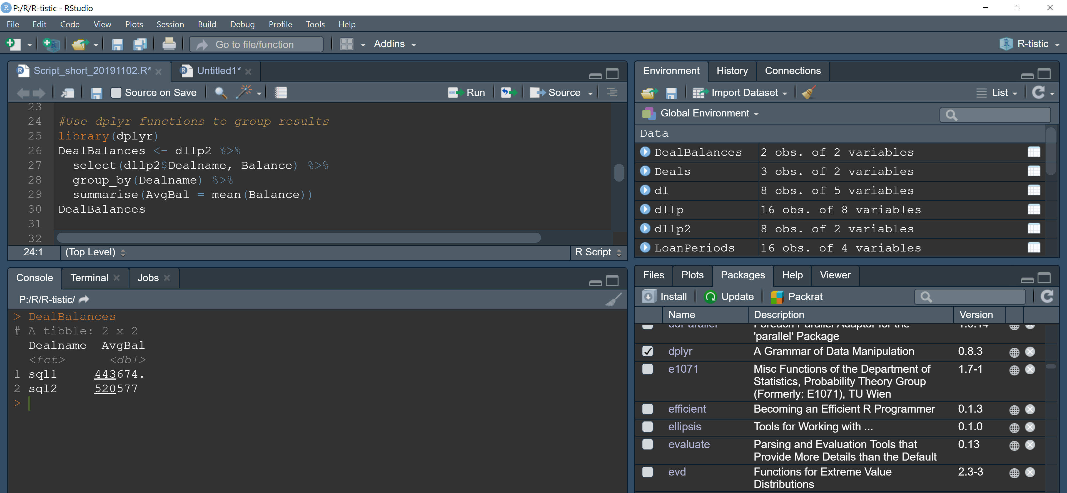
R in RStudio
Notes:
With the dplyr library the pipe operation %>% is used to group and summarize the desired result.

Slide 27
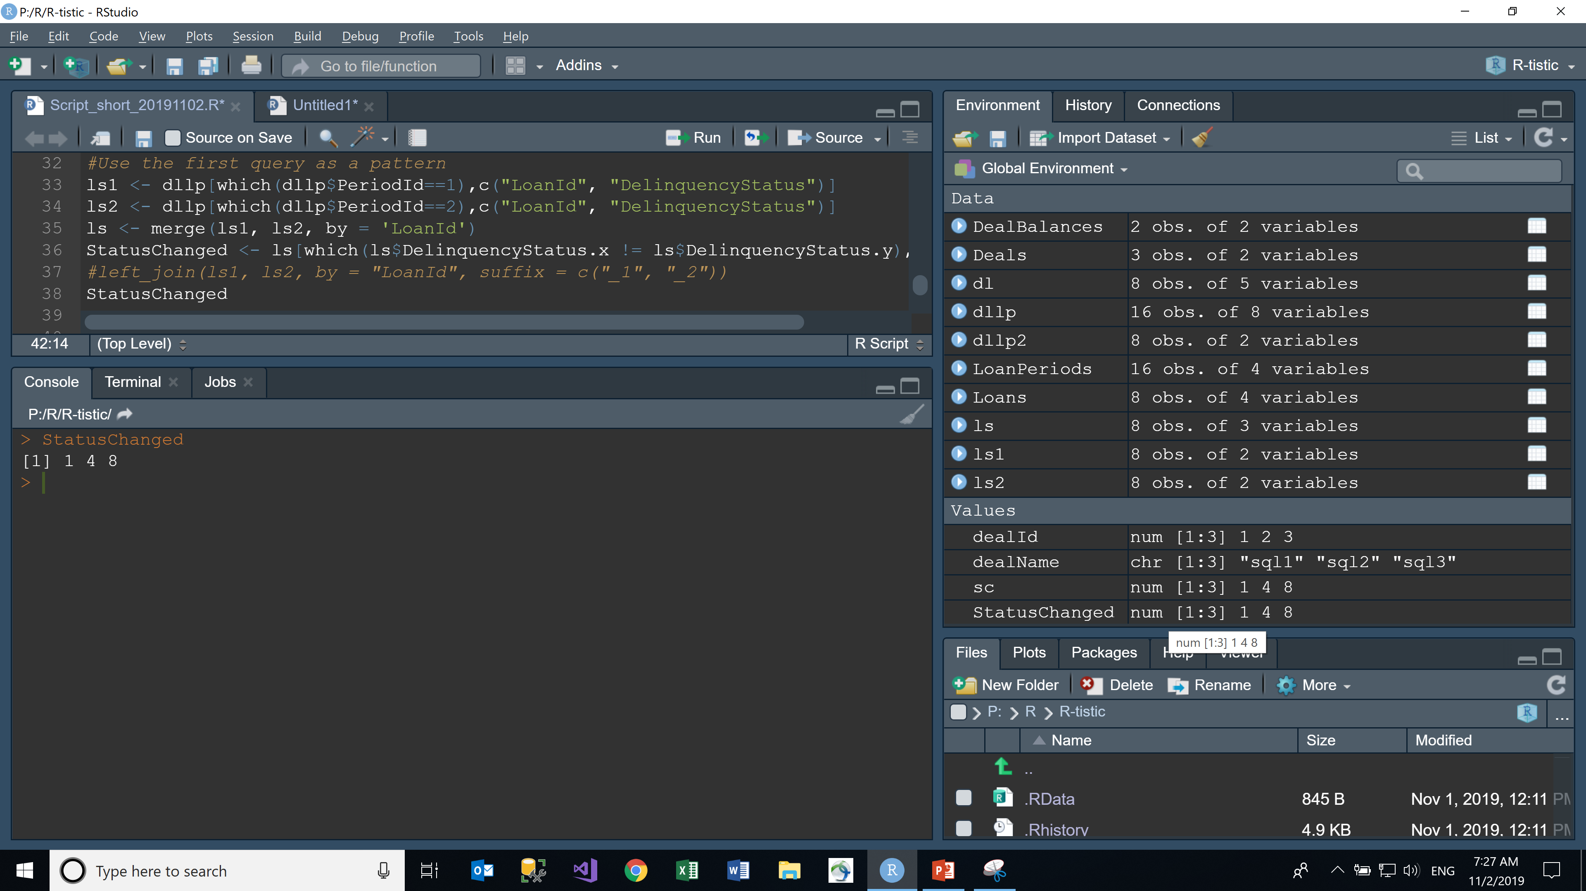
R in RStudio
Notes:
Here is a look at one way of getting to the list of LoanId’s that have had a status change. We can come back to this and do a live demo after looking at the PDF creation.

Slide 28
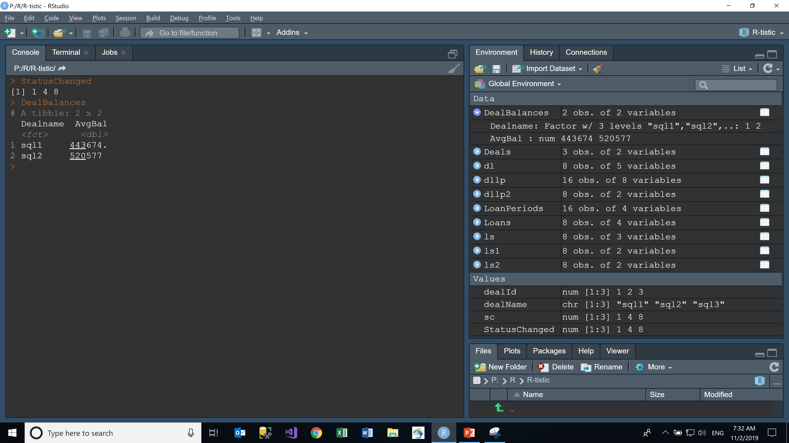
R in RStudio
Notes:
Using Markdown in R is done with scripts saved with the RMD file extension. Using the items currently in the Environment we will try to do that.

Slide 29
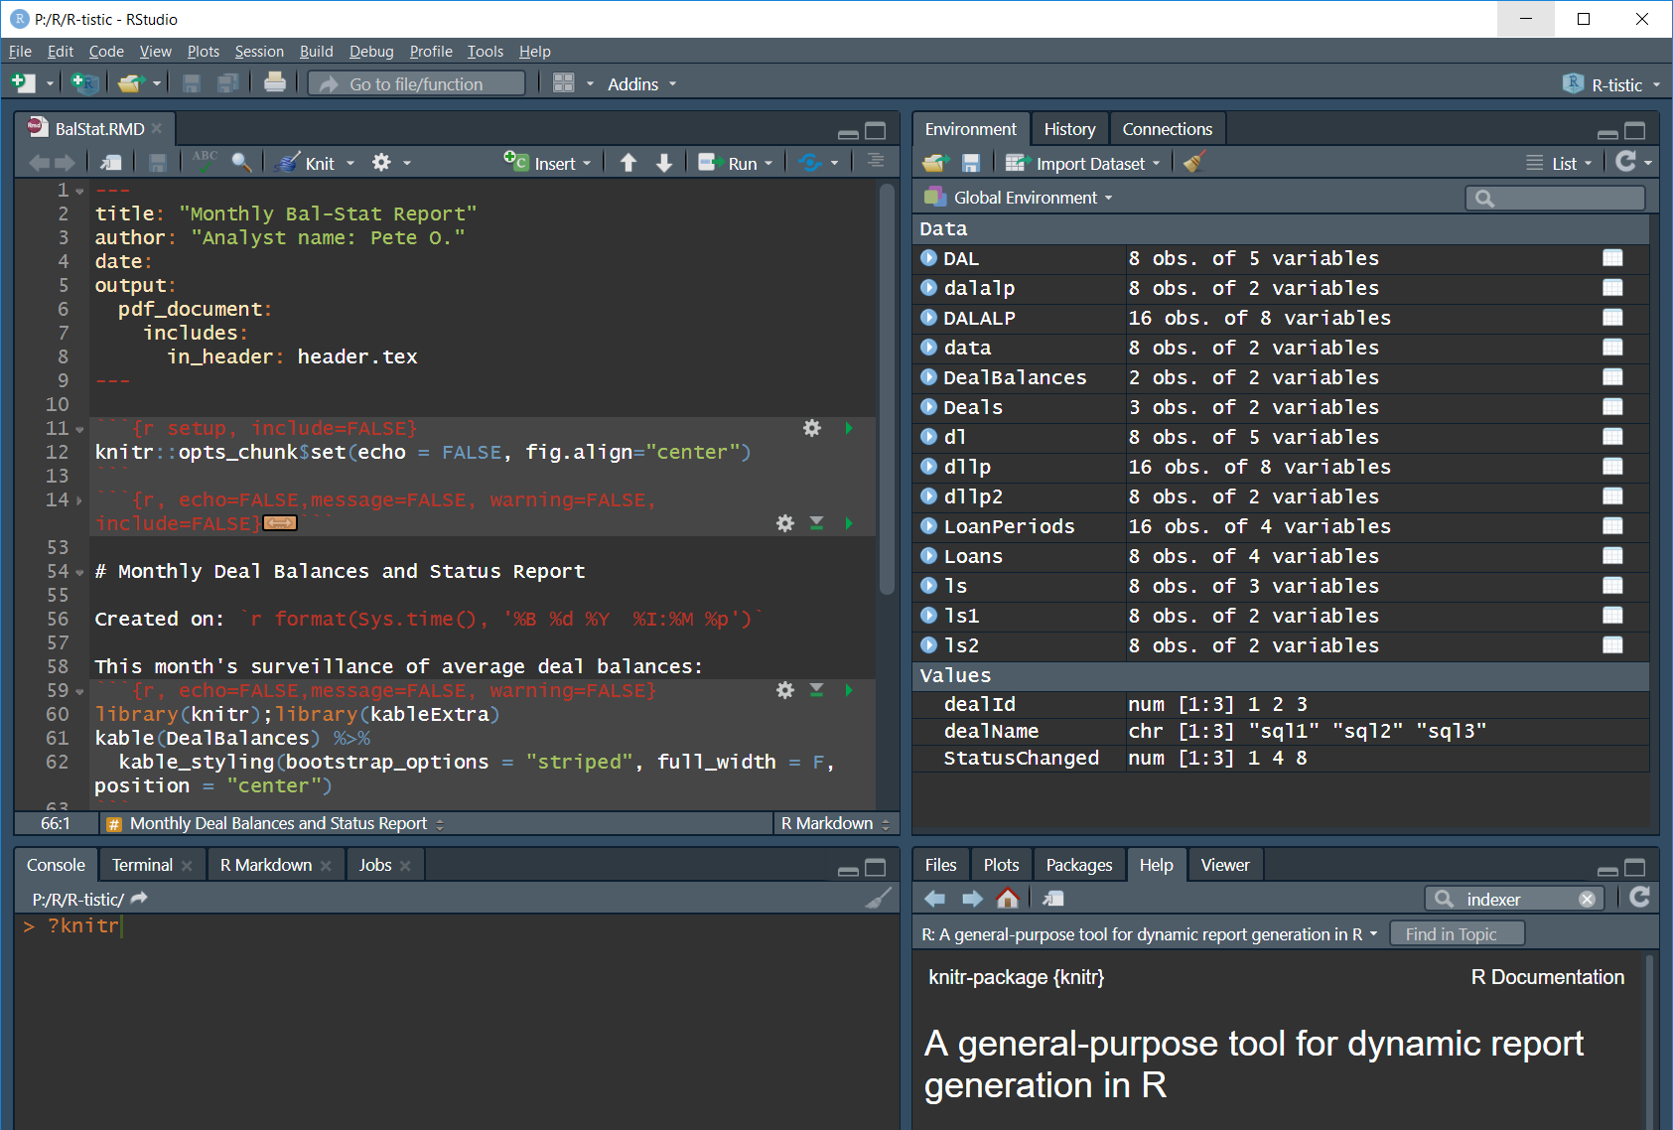
R in RStudio
Notes:
Using Markdown in R is done with scripts saved with the RMD file extension. Using the items currently in the Environment we will try to do that.

Slide 30
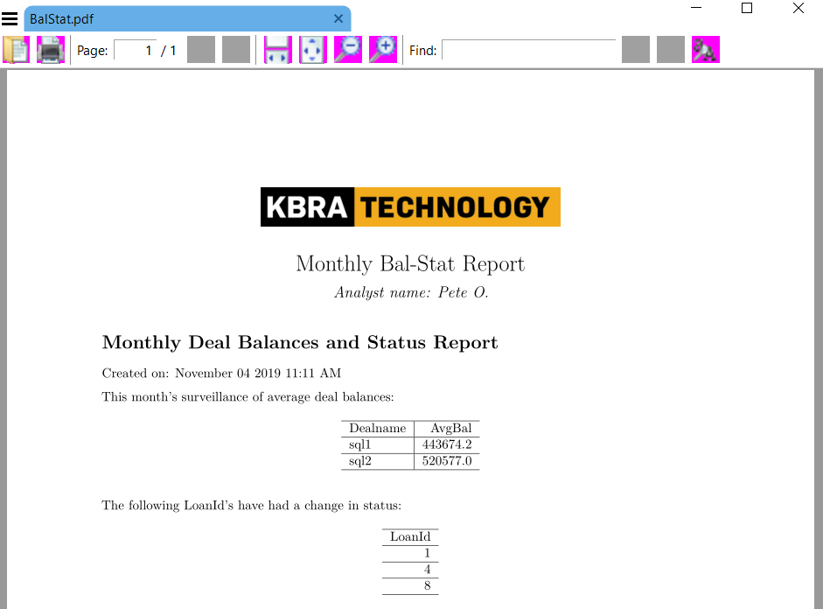
R in RStudio
Notes:
Using Markdown in R is done with scripts saved with the RMD file extension. Using the items currently in the Environment we will try to do that.

Slide 31
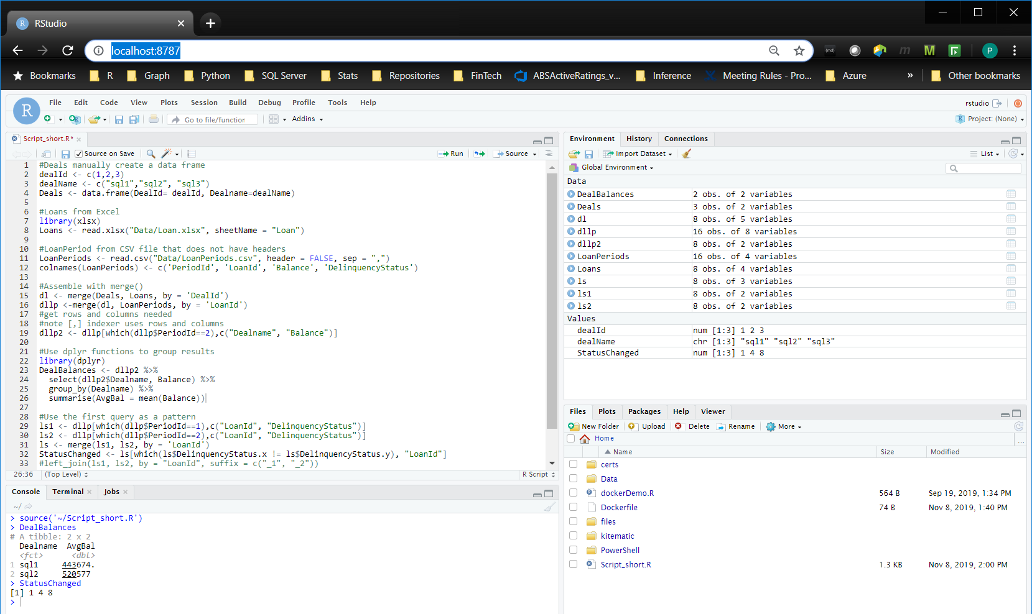
RStudio in Container
Notes:
Running on a container.
D:\docker>docker run -e PASSWORD=abcd1234 -p 8787:8787 -v d:/docker:/home/rstudio pmo

Slide 32
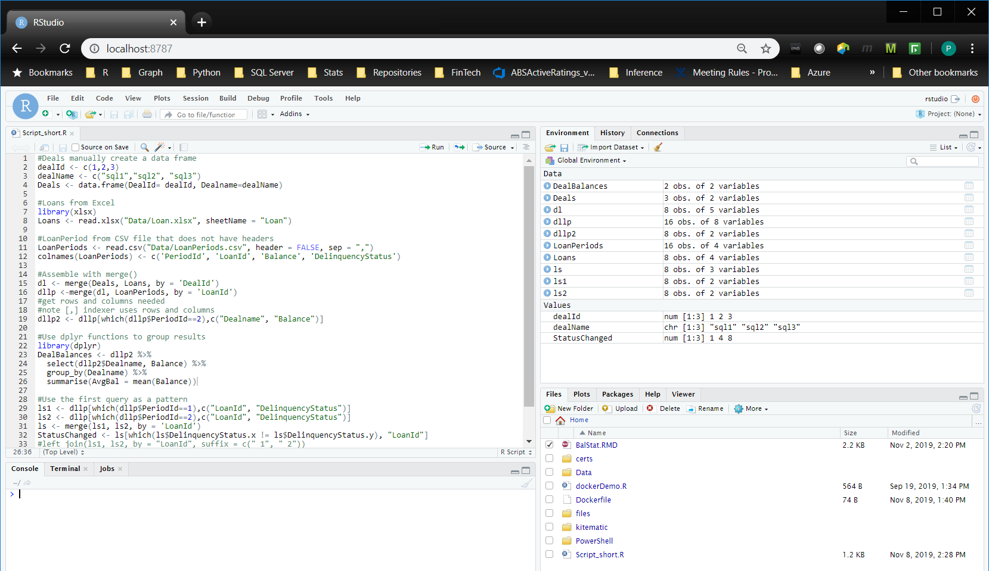
RStudio in Container
copied in after containter started
Notes:
Files can go into and out of the containers.

Slide 33
RStudio in Container
Notes:
Using Markdown in R is done with scripts saved with the RMD file extension. Using the items currently in the Environment we will try to do that.

Slide 34
Thank You
Questions
Notes:
Using Markdown in R is done with scripts saved with the RMD file extension. Using the items currently in the Environment we will try to do that.

